Slide 1
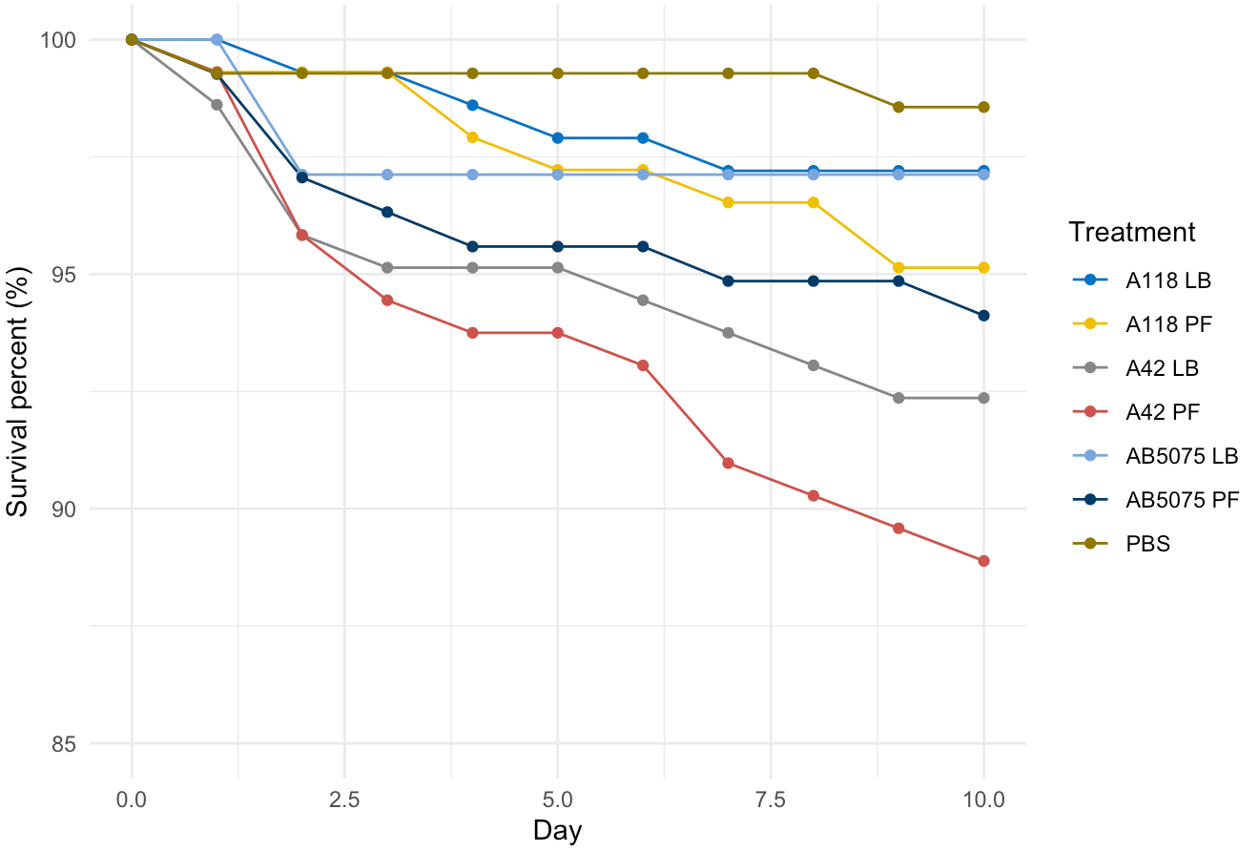
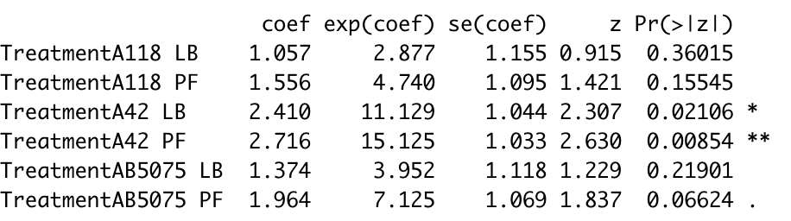
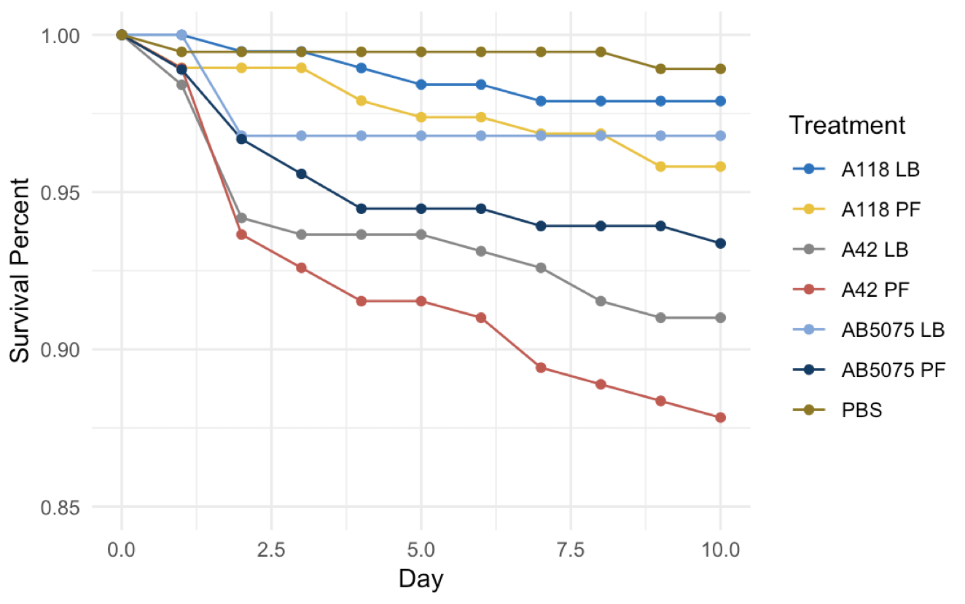
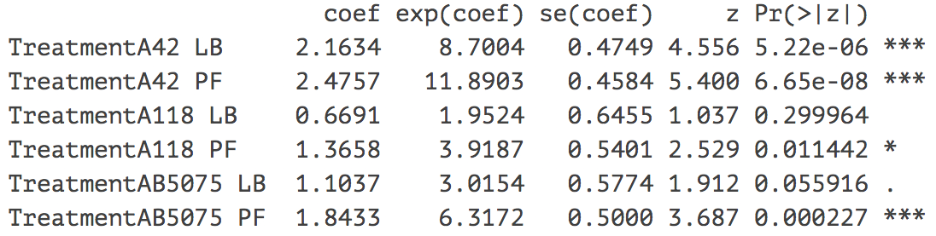
PF Paper Data
New Cox Model Results 4-22-2020
Old Cox Model Results 5-13-2019
Hazard ratios
Summary:
A42 LB: <0.001 → 0.02
A42 PF: <0.001 → 0.008
A118 LB: 0.29 → 0.36
A118 PF: 0.01 → 0.15*
AB5075 LB: 0.055 → 0.219*
AB5075 PF: <0.001 → 0.066*

Slide 2
Bacteria: A42, A118, AB5075 combined
Conditions: PBS (baseline), LB, PF
Top is a raw data plot, which illustrates the survival presents of different treatment from Day 0 to Day 10 in the study.
Bottom is a summary table of Cox PH model, which includes hazard ratios for different treatment in highlighted column. Here treatment PBS is chosen as the reference (baseline).
All the other treatments have a small p-values, except two LB’s from
Treatment A118 (LB)
Treatment AB5075 (LB)
Both are sitting close to the reference curve in the graph.
Hazard ratios

Slide 3
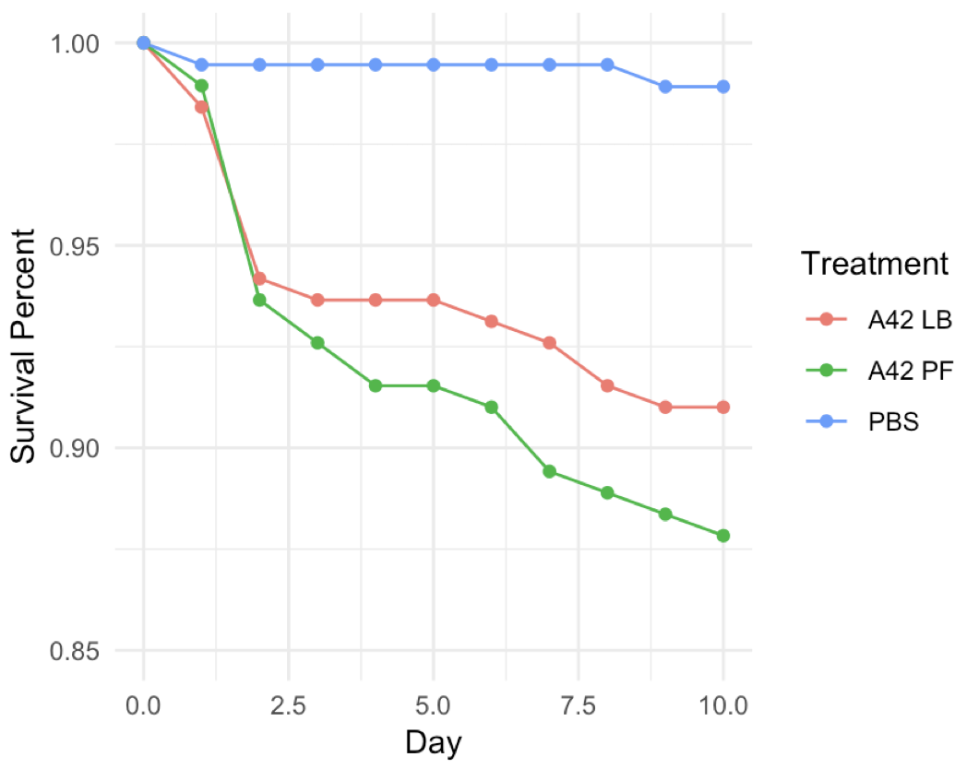
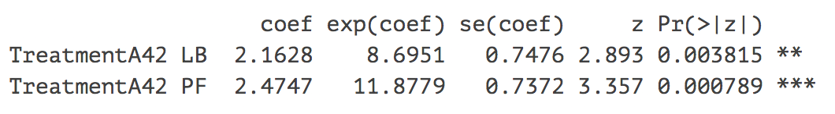
Bacteria: A42
Conditions: PBS (baseline), LB, PF
Hazard ratios

Slide 4
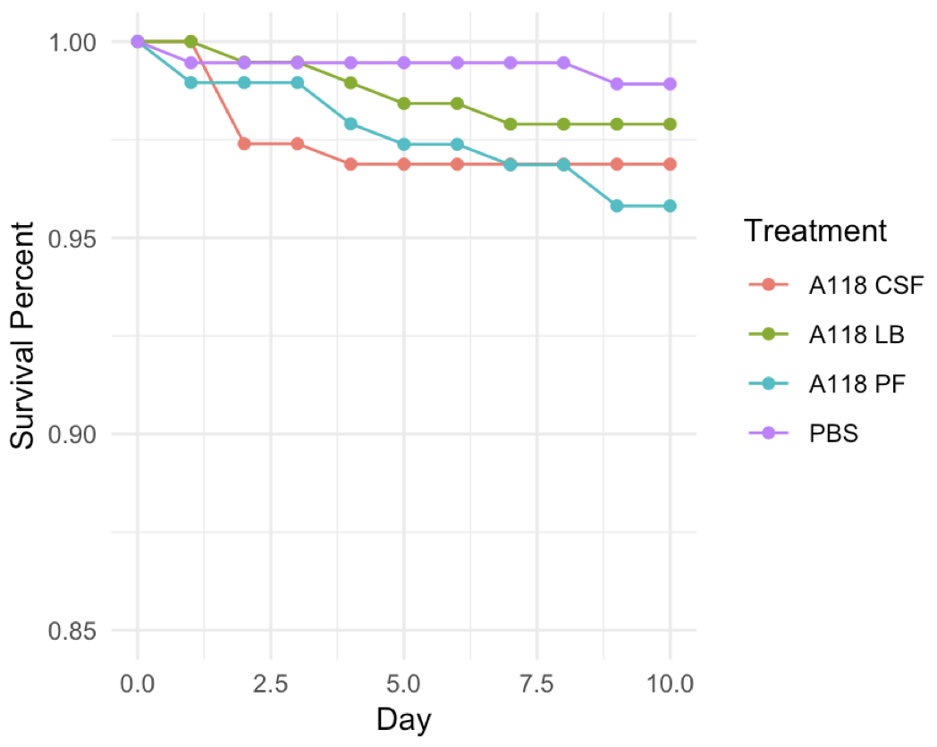
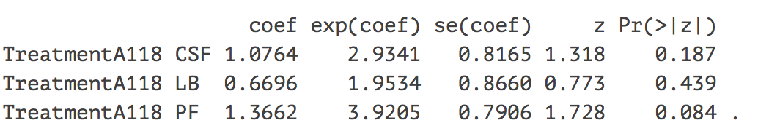
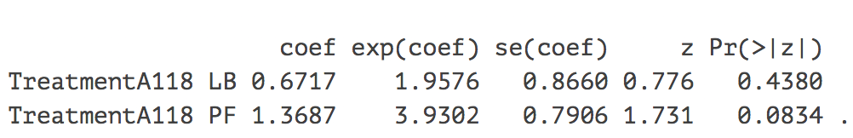
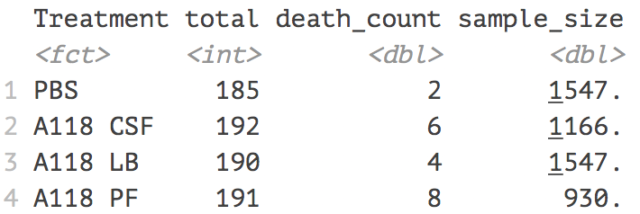
Bacteria: A118
Conditions: PBS (baseline), LB, PF, CSF
Hazard ratios
Include CSF
Remove CSF
Power analysis

Slide 5
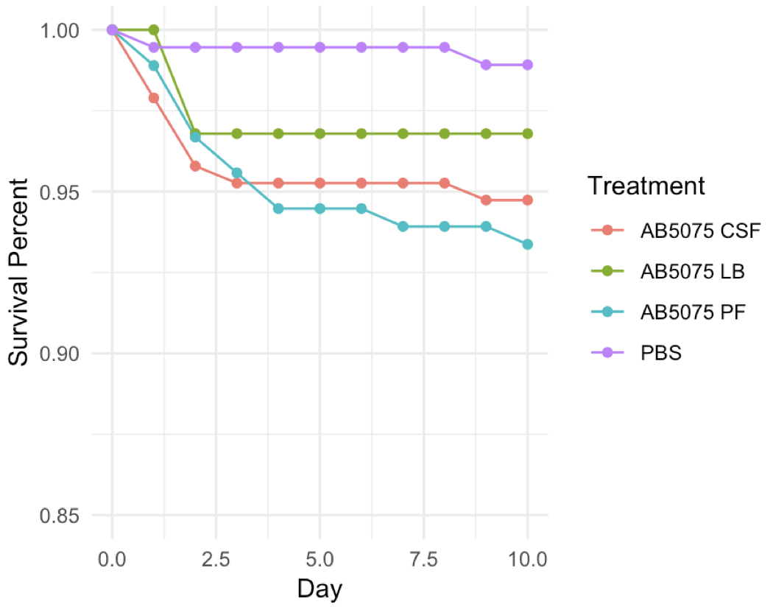
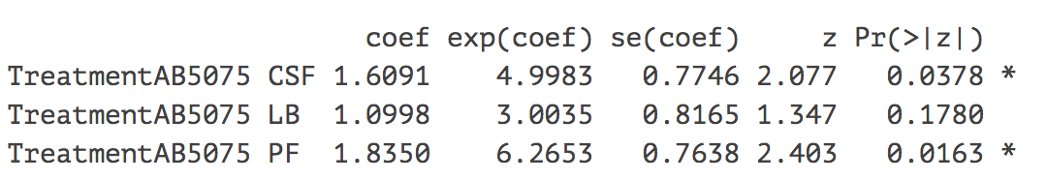
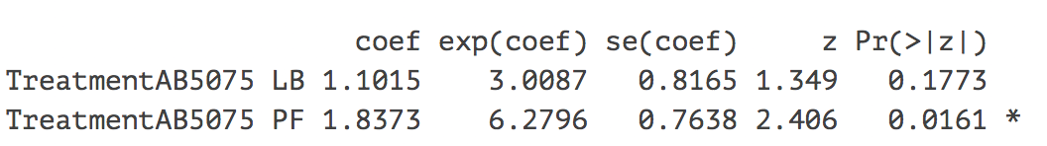
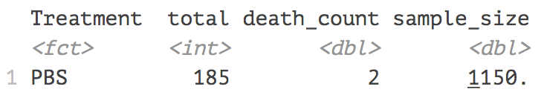
Bacteria: AB5075
Conditions: PBS (baseline), LB, PF, CSF
Hazard ratios
Include CSF
Remove CSF
Power analysis

Slide 6
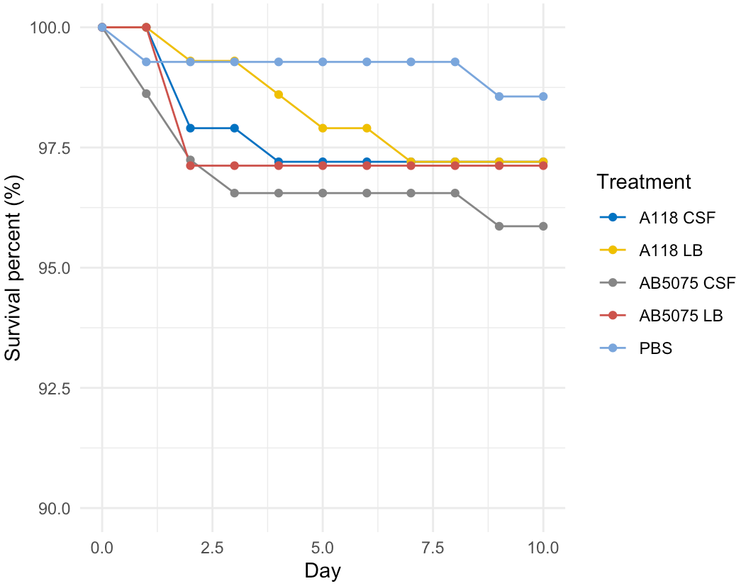
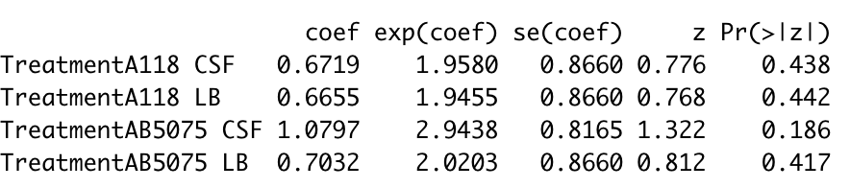
CSF Paper Data: Analysis Done 4-22-2020
Bacteria: A118, AB5075 combined
Conditions: PBS (baseline), LB, CSF
Hazard ratios

